Slide 1

TASK 3 – DASHBOARD DESIGN
Interactive Sales and Profit Dashboard using Power BI
INTERNSHIP PROGRAM: ELEVATE LABS – DATA ANALYST INTERNSHIP
Dataset Used: Superstore Sales Dataset (Kaggle)
Tool Used: Power BI Desktop
NAME: ABDUL AHAD SHAIKH

Slide 2

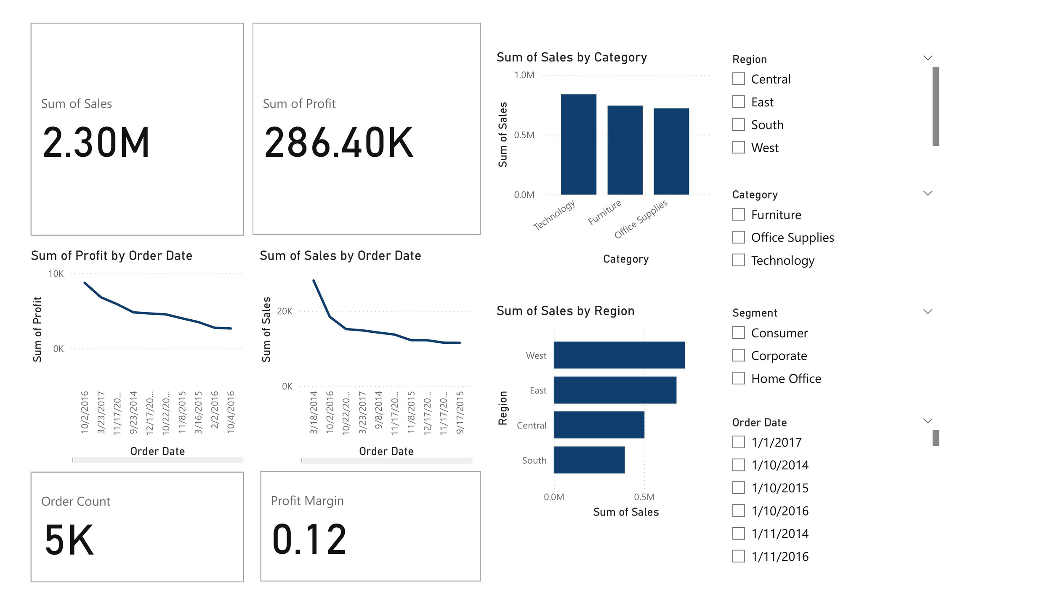
DASHBOARD OVERVIEW
KPI Cards: Total Sales, Profit, Order Count, Profit Margin
Line Charts: Monthly Sales and Profit Trends
Bar Charts: Sales by Category, Region
Slicers: Region, Segment, Category, and Order Date

Slide 3

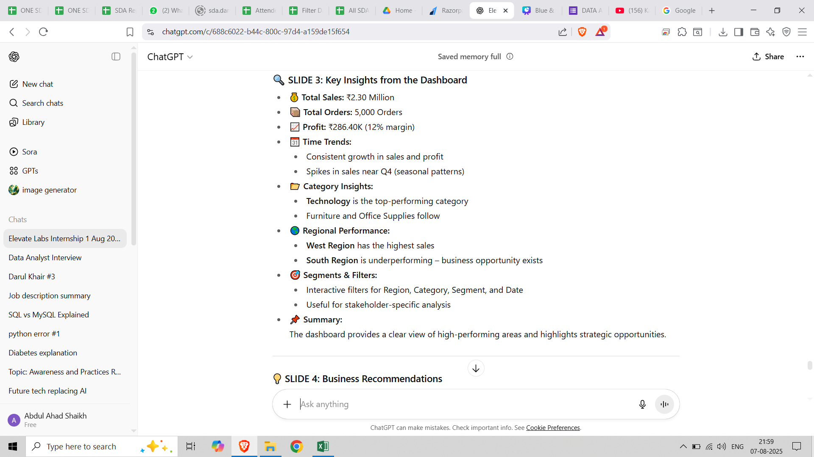
KEY INSIGHTS FROM THE DASHBOARD

Slide 4


BUSINESS RECOMMENDATIONS
3. Boost Low-Performing Regions
Run localized promotions in the South and Central regions
Provide sales support and better logistics in those areas
1. Scale What's Working
Increase focus on the Technology category
Launch new products and bundle offers in the West Region
4. Segment-Specific Actions
Create targeted deals for Corporate and Home Office segments
2. Improve Profitability
Review low-profit months and reduce operational costs
Adjust pricing and discount strategies to increase margin above 12%
5. Use Seasonality
Plan Q4 campaigns early based on past trends
Optimize inventory and delivery before peak seasons

Slide 5

THANK YOU

